Slide 1
What is a
Human being?
How can we “conceptualize” - think about - human beings?

Slide 2
Biological
Determinism

Slide 3
Biological Determinism
The “strong” claims that (1) Peoples’ actions are greatly affected—if not totally determined—by
their genetic endowment: the genes that comprise their genome.
“Purple” people—by their nature; due to the genes they
possess—are more likely to have violent or overly-aggressive
tendencies and, as a result, commit more crimes than others.
“Green” people—by their nature; due to the genes they
possess—are more likely to be sexually promiscuous and,
as a result are more likely to be guilty of rape and infidelity
than others.
“Orange” people—by their nature; due to the genes they
possess—are less intelligent than others and, as a result, are
more likely to make poor choices in life.

Slide 4
“The Apple Doesn’t Fall
Far From the Tree”

Slide 5
Eugenics

Slide 6
Eugenics: The “Well-born” Science
The word "eugenics" was coined in
1883 by Francis Galton, a cousin of
Charles Darwin. He took the word
from the Greek root meaning “good
in birth” or “noble in heredity.”
He intended it to denote the “science”
of improving human stock by giving
“the more suitable races or strains of
blood a better chance of prevailing
speedily over the less suitable.”
Sir Francis Galton
1822 - 1911

Slide 7
Social Contexts – Social Problems
Habitual criminals and the high cost of justice
Industrialization and the Flood of Immigration
“Race Suicide” — declining birth rates
The “Woman Problem” – changing morals; birth control
“The Menace of the Feebleminded”

Slide 8
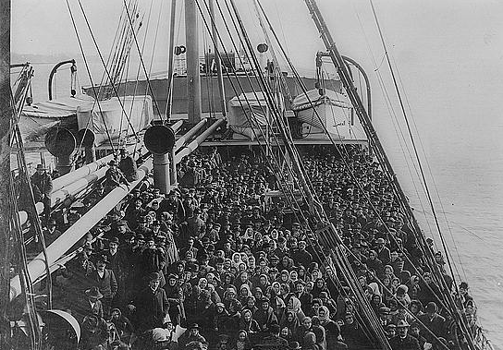
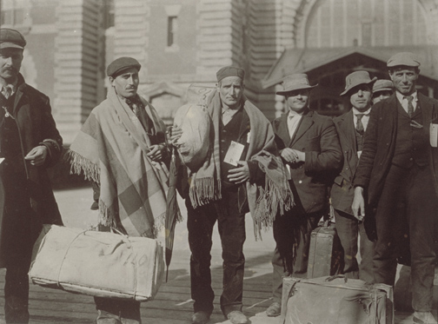
Social Contexts – Social Problems
Industrialization and the Flood of Immigration

Slide 9
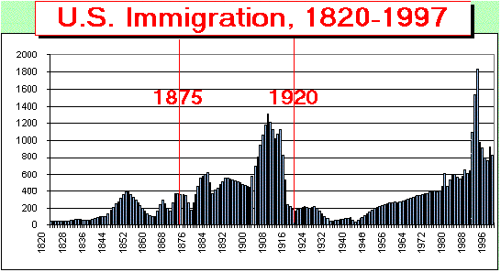

Slide 10
The Dillingham Commission
1907 - 1911
In 1907, the United States Senate, under intense pressure
from groups like the Immigration Restriction League, formed
the Dillingham Commission to study the origins and
consequences of immigration. In a series of reports published
in 1910 and 1911, the Commission claimed that a crucial
shift in European immigration patterns corresponded to the
rise of social and economic problems in the United States.
Before the 1880s, according to the Commission, most migrants
to the United States had arrived from northern and western
Europe.

Slide 11
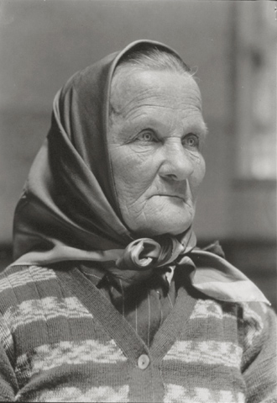
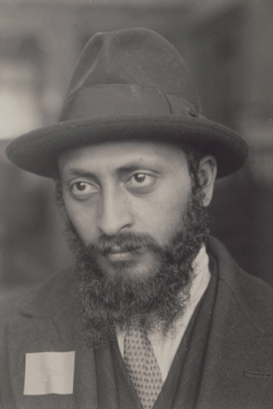
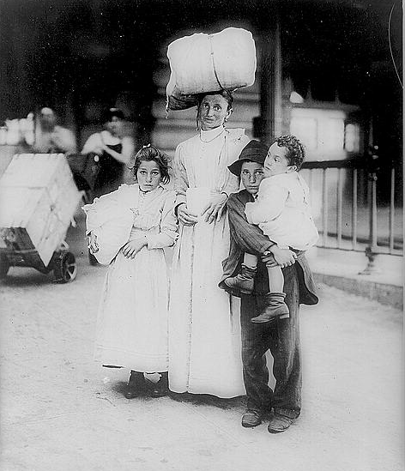
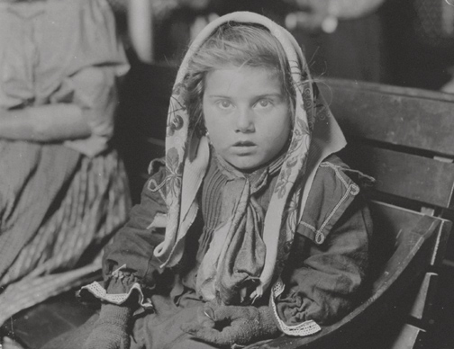
The Dillingham Commission
1907 - 1911
After the 1880s, however, “inferior” migrants from places in
southeastern Europe, such as Austria-Hungary, Russia, Italy,
Turkey, Lithuania, Romania, and Greece, increasingly
dominated European immigration.

Slide 12
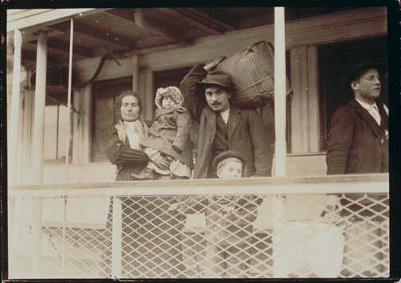
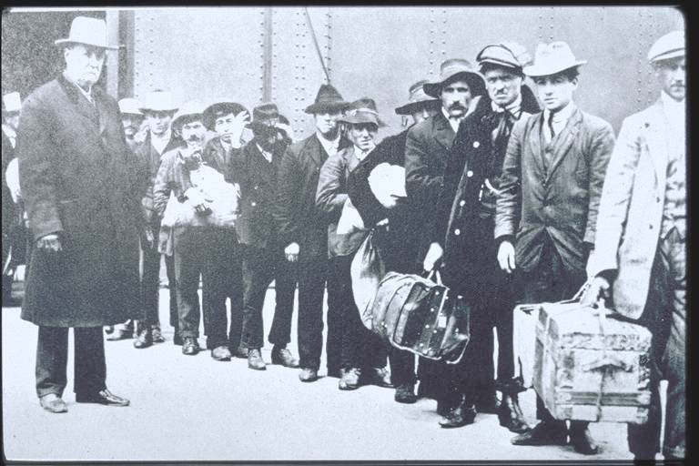
The Dillingham Commission
1907 - 1911
In the end, the Commission's 42-volume report placed the
blame for the nation's problems on these new migrants and
recommended that the federal government use literacy tests
to prevent poor and uneducated immigrants from entering
the nation and causing further social unrest.

Slide 13
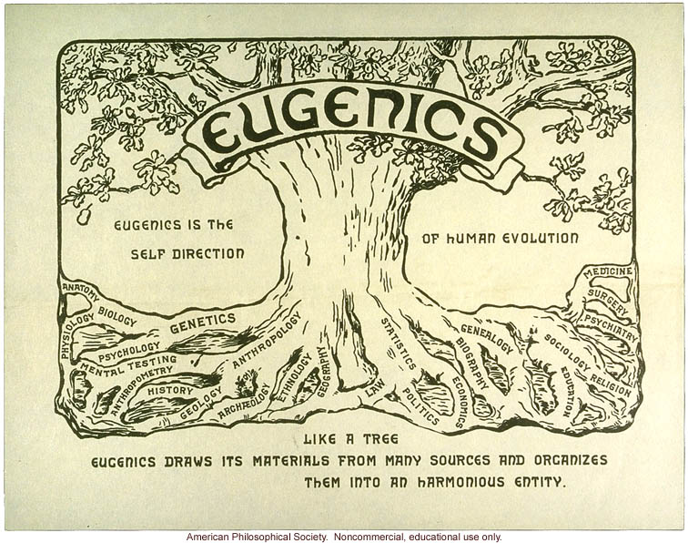

Slide 14
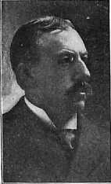
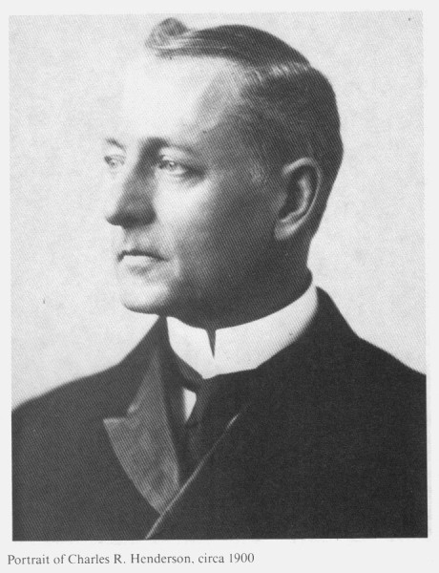
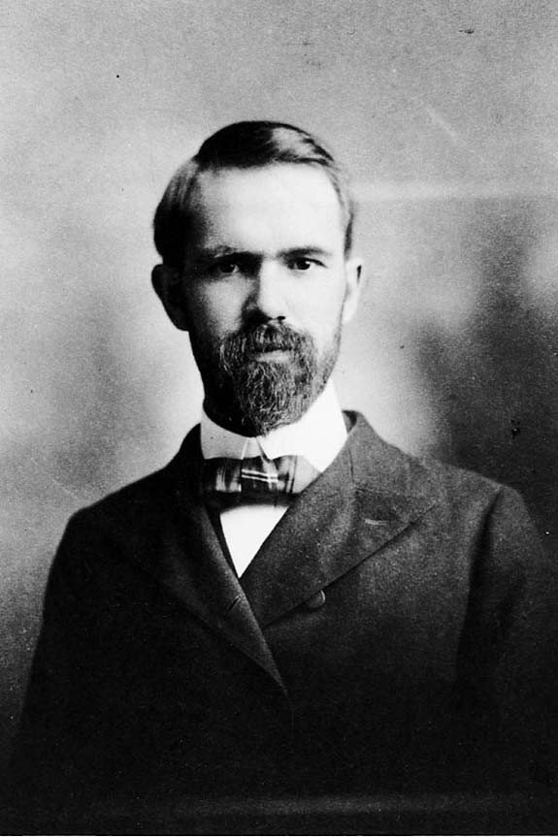
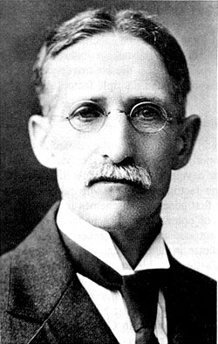
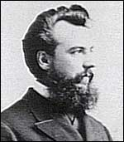
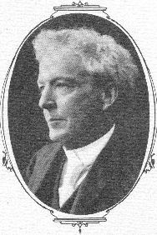
The ABA Committee on Eugenics, 1906
In addition to the goals of research into human heredity,
the Committee on Eugenics wished “to emphasize the value
of superior blood and the menace to society of inferior blood”
and to suggest “methods of improving the heredity of the
family, the people, or the race.” Chaired by David Starr
Jordan, President of Stanford University, many prominent
scientists were members:
David Starr Jordan
Stanford University
Charles Henderson
University of Chicago
Sociologist
Charles B. Davenport
Eugenics Record Office
William Castle
Harvard University
Alexander Graham
Bell
Luther Burbank,
plant breeder

Slide 15
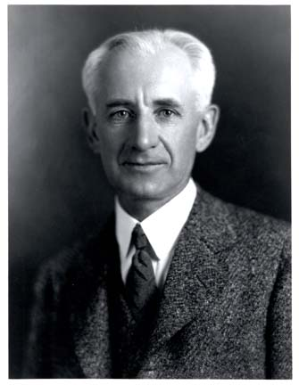
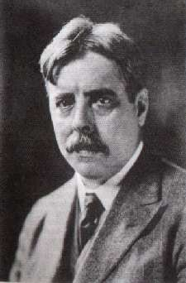
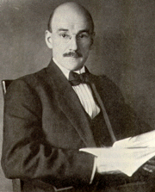
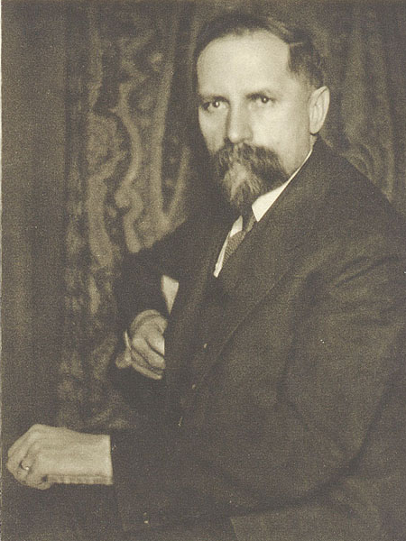
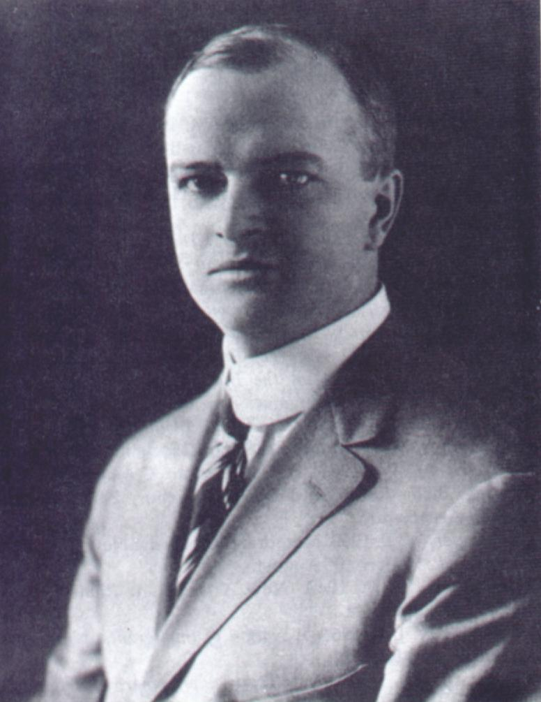
The ABA Committee on Eugenics
10 Sub-committees
Inheritance of Mental Traits
Feeblemindedness
Heredity of Insanity
Epilepsy
Eye Defects
Genealogy
Robert Yerkes
Psychologist
Chairman
E. L. Thorndike
Psychologist
Columbia University
Henry Goddard
Psychologist
Vineland Training School
Adolph Meyer
Psychiatrist
Inheritance of
Deaf-Mutism
Criminality
Sterilization and Other Means of
Eliminating Defective Germ Plasm
Immigration
Prescott F. Hall
Robert DeCourcy Ward
Alexander Graham Bell,
chairman
Charles Henderson
University of Chicago
Sociologist
Harry Laughlin

Slide 16
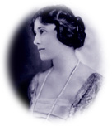
The Eugenics Record Office
1910
Mary Harriman, daughter of railroad tycoon E. H. Harriman,
spent part of the summer of 1905 at Davenport’s Cold Spring
Harbor Biological Laboratory while an undergraduate at
Barnard College. A social activist with liberal leanings, Mary
thought that Davenport’s ideas about eugenics offered a means
to improve social conditions. Her classmates gave her the
nickname “Eugenia” due to her interest in eugenics.

Slide 17
The American
Eugenics Society

Slide 18
Psychology

Slide 19
Human Beings
are Learning
Machines

Slide 20
Learning
A relatively permanent
change in behavior due to experience

Slide 21
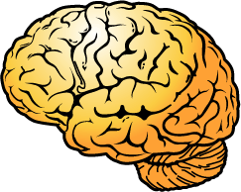
“Black - Boxing the Brain”
STIMULUS
RESPONSE
CLASSICAL CONDITIONING
RESPONSE
STIMULUS
Reinforcement or
Punishment
INSTRUMENTAL CONDITIONING

Slide 22
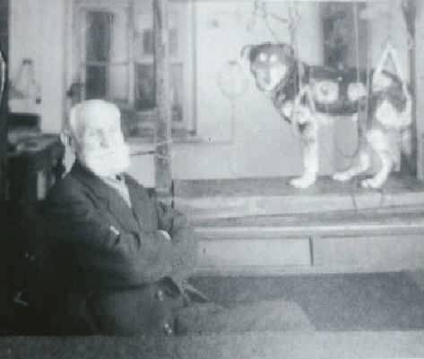
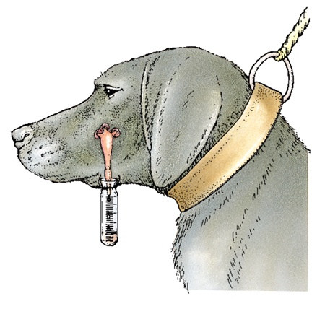
“LEARNING”
CLASSICAL CONDITIONING
Influence of Pavlov
1849 - 1936
Pavlov (1902) started from the idea that there are some things that a dog does not need to learn. For example, dogs don’t learn to salivate when presented with food. This reflex is ‘hard-wired’ into the dog.

Slide 23
“LEARNING”
CLASSICAL CONDITIONING
Influence of Pavlov
1849 - 1936
Pavlov used a metronome as his neutral stimulus. By itself the metronome did not elicit a response from the dogs.
Next, Pavlov began the conditioning procedure, whereby the clicking metronome was introduced just before he gave food to his dogs. After a number of repeats (trials) of this procedure he presented the metronome on its own

Slide 24
“LEARNING”
CLASSICAL CONDITIONING
Influence of Pavlov
1849 - 1936
The sound of the clicking metronome on its own now caused an increase in salivation. The dog had learned an association between the metronome and the food. Because this response was learned (or conditioned), it is called a conditioned response The neutral stimulus has become a conditioned stimulus.

Slide 25
“LEARNING”
CLASSICAL CONDITIONING
Built on the foundation of reflexes
Unconditioned stimulus (UCS) elicits
Unconditioned response (UCR)
Neutral stimulus is paired with
the unconditioned stimulus
close in time and repeatedly
Neutral stimulus acquires the power to elicits the response.
Neutral stimulus is now the
conditioned stimulus (CS) which
elicits the conditioned response (CR).

Slide 26
“Black - Boxing the Brain”
STIMULUS
RESPONSE
CLASSICAL CONDITIONING
RESPONSE
STIMULUS
Reinforcement or
Punishment
INSTRUMENTAL CONDITIONING

Slide 27
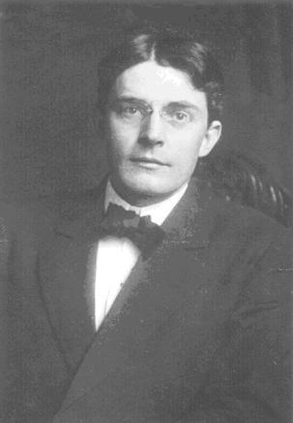
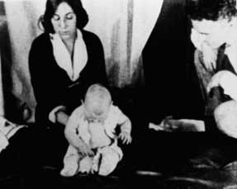
The Individual, Social, and Cognitive Back Story of John Broadus Watson
And “Little Albert”
John Broadus Watson
1878-1958
The “Little Albert Studies”
1920

Slide 28
Watson and the University of Chicago
Watson entered the University of Chicago in the fall of 1900. He is described as “an ambitious, status-conscious young man desperately insecure about his lack of means and social sophistication. He had $50 in his pocket and paid his board and tuition by working as an assistant janitor at the university and a waiter in a students’ boardinghouse. He chose experimental psychology as his major field and was drawn to animal psychology, doing research under the direction of Jacques Loeb. It is during this time that Watson became convinced that man was but a biological mechanism. ” (Kerry Buckley, Mechanical Man, 1989)

Slide 29
Watson and the University of Chicago
“Watson found his identity with those of his generation who discovered that the problems created by an expanding industrial society also provided opportunities for new professions that offered solutions to these problems. When Watson entered the University of Chicago, psychology was considered to be one of the newest professions with particular promise.”
(Kerry Buckley, Mechanical Man, 1989)

Slide 30
Watson and “Psychology as the Behaviorist Views It”
In 1913 Watson delivered a series of lectures at Columbia University, which “sent reverberations throughout the psychological community. Watson coined the term “Behaviorism” to distinguish his brand of psychology from the Structuralists and Functionalists.

Slide 31
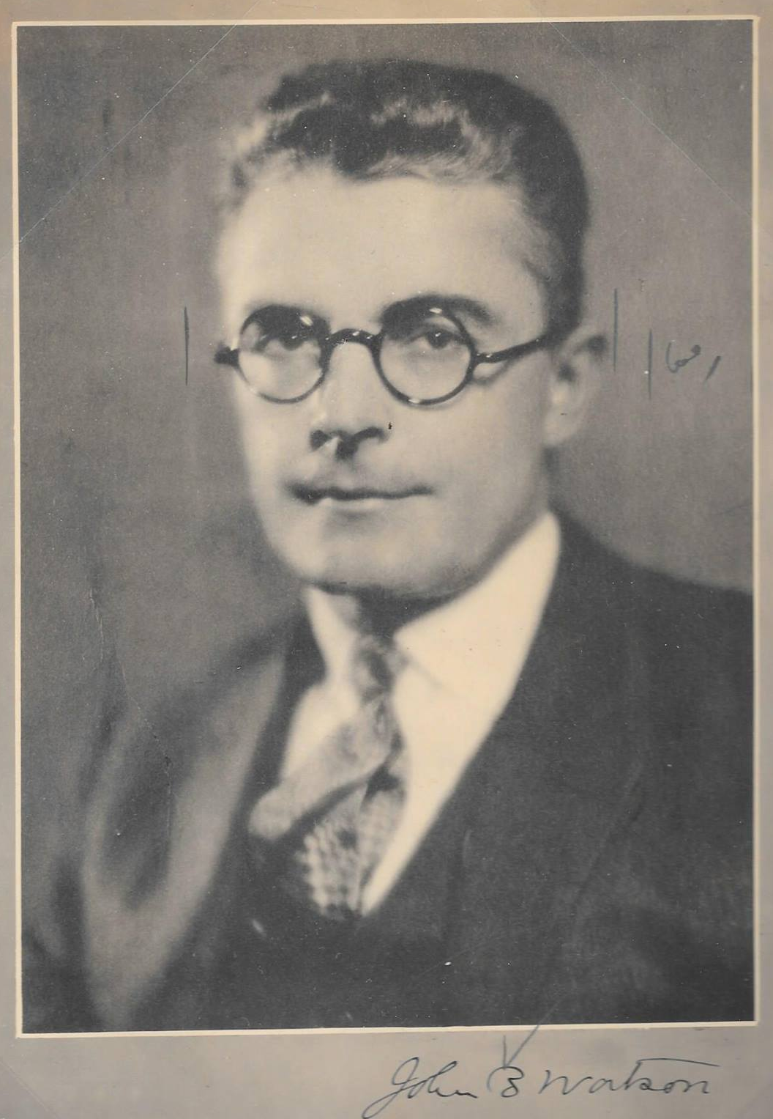
“Behaviorism”
John B. Watson
“Psychology, as the behaviorist views it, is
a purely objective, experimental branch of
natural science which needs introspection
as little as do the sciences of chemistry and
physics.”
“There are for us no instincts – we no longer
need the term in psychology. Everything we
have been in the habit of calling an
“instinct” today is a result largely of training –
belonging to man’s learned behavior.”
1878 - 1958
“[Consciousness] has never been seen, touched,
smelled, tasted or moved. It is plain assumption just
as unprovable as the old concept of the soul.”
(1913 Lecture series)

Slide 32
The Human Infant Studies
Watson’s interest was in creating and refining an objective methodology for deriving a behavioral theory of emotional response.
“I am next door to the obstetrical ward here and I get about forty babies a month. These babies are sent over to the laboratory on demand and we can make the observations right here.”
The focus of Watson’s research was to gain “experimental control over the whole range of emotional reactions.” His 1916 experiments, he claimed, uncovered the basic emotional reactions fundamental to the nature of man—fear, rage, and love.

Slide 33
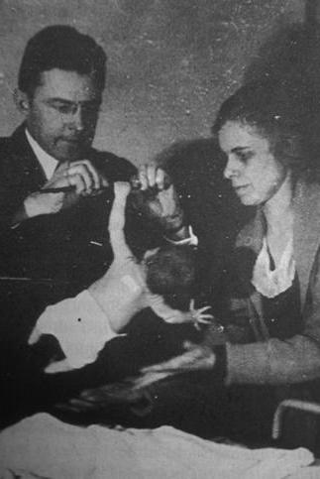
The Human Infant Studies
Watson’s work with infants began as early as 1916.
Watson testing the tonic grasp instinct.
“Babies are not hothouse plants and can be subjected to laboratory experiments without the slightest harm.”

Slide 34
The Human Infant Studies
Watson elicited fear by dropping the infant, by loud sounds, or by startling it when asleep.
Rage was elicited by hindering movements.
Love was produced by “stroking or manipulation of some erogenous zone.”
Habits or conditioned responses were found to be connected with these basic emotional responses at a very early stage, and these habits, he argued, should be controlled.

Slide 35
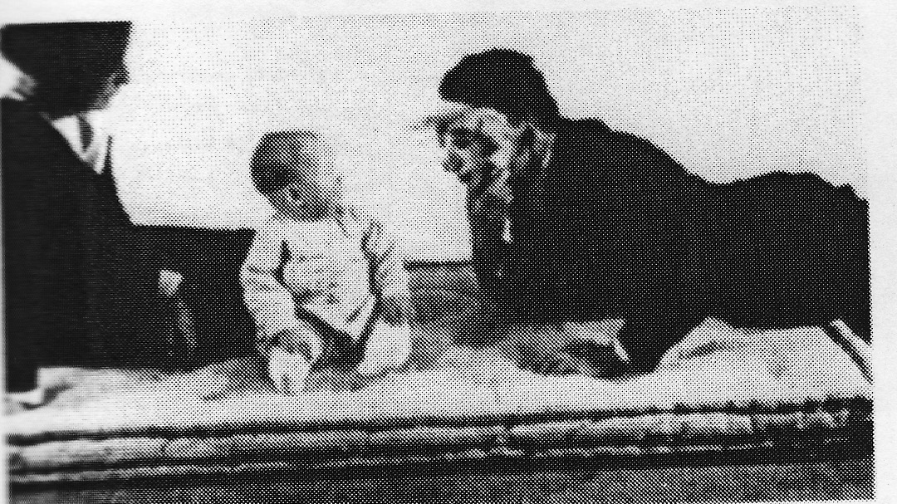
The “Little Albert” Studies, 1920
During the winter of 1919-1920, with his graduate assistant Rosalie Rayner, he began a series of experiments with a nine-month old infant, Albert B. Watson attempted to prove that the responses of fear, rage, and love could be artificially induced in the subject. Little Albert

Slide 36
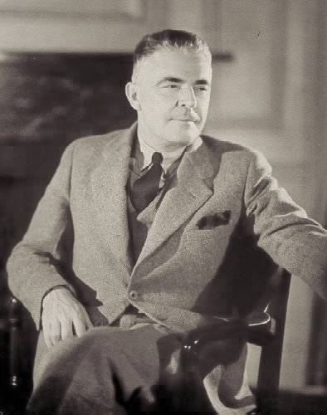
“Behaviorism” - John B. Watson
“Give me a dozen healthy infants,
well-formed, and my own specified
world to bring them up in and I’ll
guarantee to take any one at random
and train him to become any type
of specialist I might select – doctor,
lawyer, artist, merchant-chief, and,
yes, even beggar-man and thief,
regardless of his talents, penchants,
tendencies, abilities, vocations, and
race of his ancestors.”
John B. Watson, Behaviorism, 1924
1878-1958

Slide 37
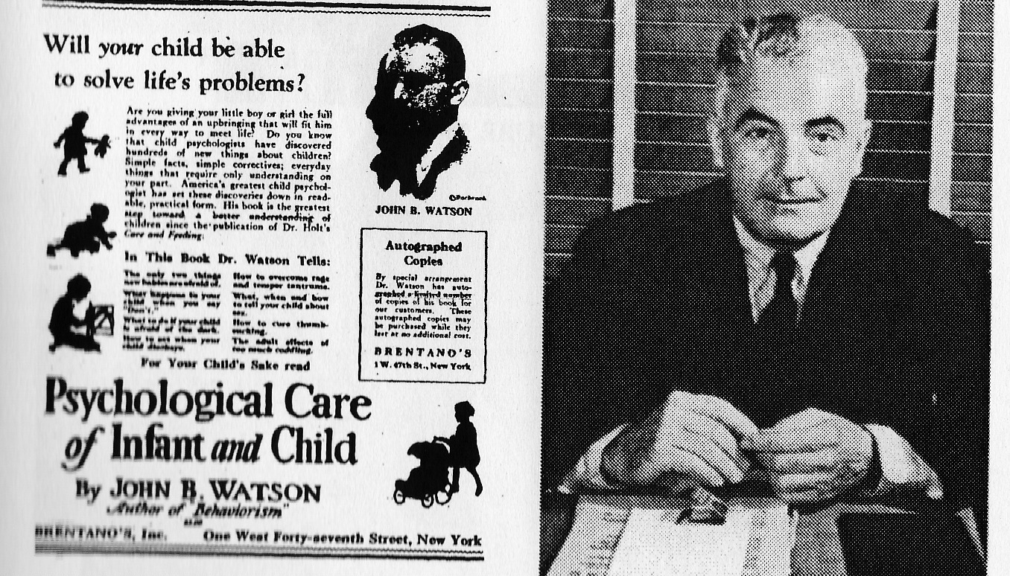
Watson as Popularizer of Behaviorism

Slide 38
Watson as Popularizer of Behaviorism
“…all we have to start with in building
a human being is a lively squirming bit
of flesh, capable of making a few simple
responses such as movements of the hands
and arms and fingers and toes, crying and
smiling, making certain sounds with its
throat. I said there that parents take this
raw material and begin to fashion it in
ways to suit themselves. This means that
parents, whether they know it or not,
start intensive training of the child at birth.”
John B. Watson, Psychological Care of Infant
and Child (1928)
1878-1958

Slide 39
“Behaviorism” - John B. Watson
“It is especially easy to shape the
emotional life at this early age. I might
make this simple comparison: The
fabricator of metal takes his heated
mass, places it upon the anvil and
begins to shape it according to patterns
of his own. Sometimes he uses a heavy
hammer, sometimes a light one; sometimes
he strikes the yielding mass a mighty blow,
sometimes he gives it just a touch. So
inevitably do we begin at birth to shape the
emotional life of our children.”
John B. Watson, "Psychological Care of Infant
and Child" (1928)
1878-1958

Slide 40
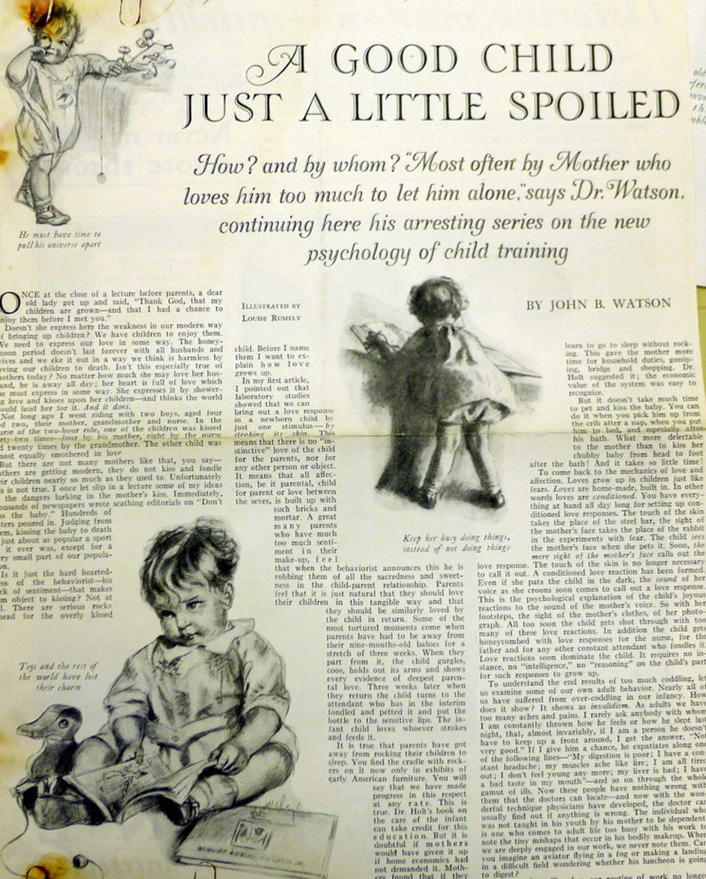
Watson as Popularizer of Behaviorism
1878-1958

Slide 41
Watson as Popularizer of Behaviorism
“Wives haven’t enough to do today. Scientific
mass production has made their tasks so easy
that they are over-burdened with time.”
“They utilize this time in destroying the
happiness of their children.”
“Never hug and kiss them, never let them sit
on your lap. If you must, kiss them once on
the forehead when they say good night. Shake
hands with them in the morning…”
He dedicated his widely read Psychological Care
of the Infant and Child to the “first mother who
brings up a happy child.”
1878-1958

Slide 42
“Black - Boxing the Brain”
STIMULUS
RESPONSE
CLASSICAL CONDITIONING
RESPONSE
STIMULUS
Reinforcement or
Punishment
INSTRUMENTAL CONDITIONING

Slide 43
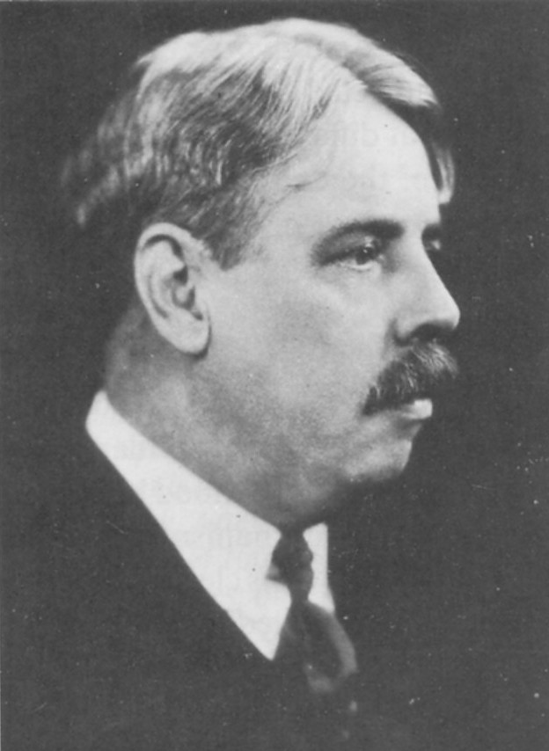
“LEARNING”
INSTRUMENTAL/OPERANT
CONDITIONING
Influence of Thorndike
1874 - 1949
Thorndike's Law of Effect:
Responses to a situation that are followed by satisfaction are strengthened.
&
Responses that are followed
by discomfort are weakened.

Slide 44
Instrumental or Operant Conditioning
Thorndike's Law of Effect:
Responses to a situation that are followed
by satisfaction are strengthened;
&
Responses that are followed by discomfort
are weakened
Edward L. Thorndike
1874 - 1949

Slide 45
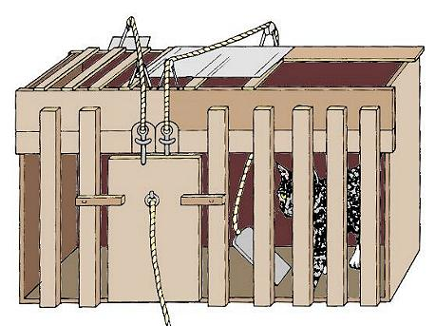
Edward L. Thorndike - Puzzle Box

Slide 46
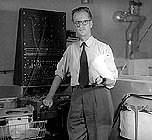
B. F. Skinner
1904 - 1990
R
S
Reinforcements Punishments

Slide 47
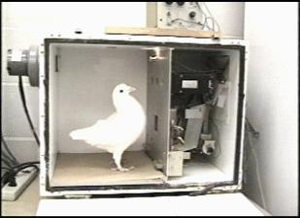
B.F. Skinner and Behavior Modification
B. F. “Fred” Skinner

Slide 48
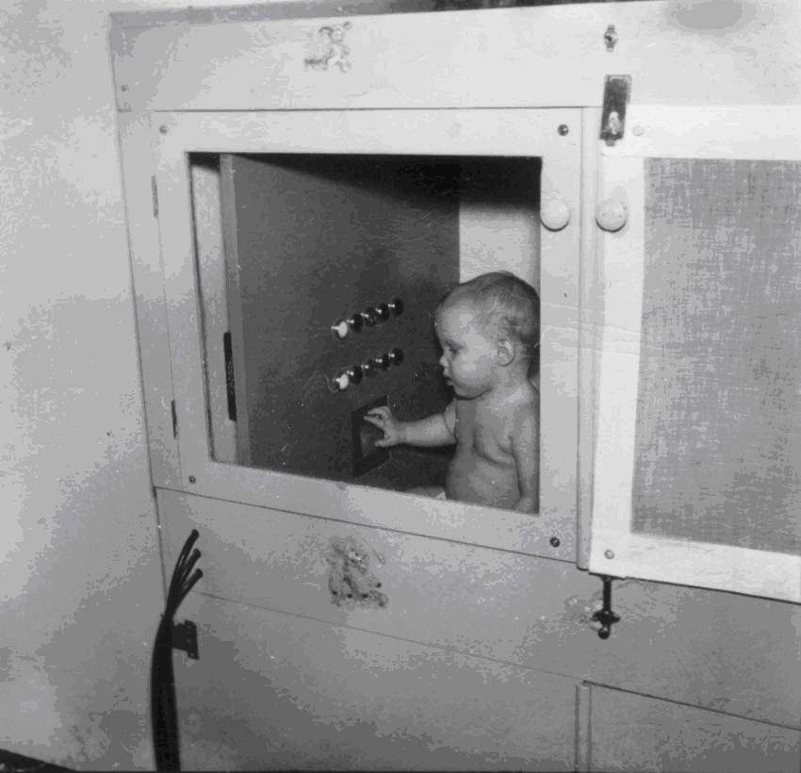
B.F. Skinner and Behavior Modification
B. F. “Fred” Skinner

Slide 49
Sheldon & Penny

Slide 50
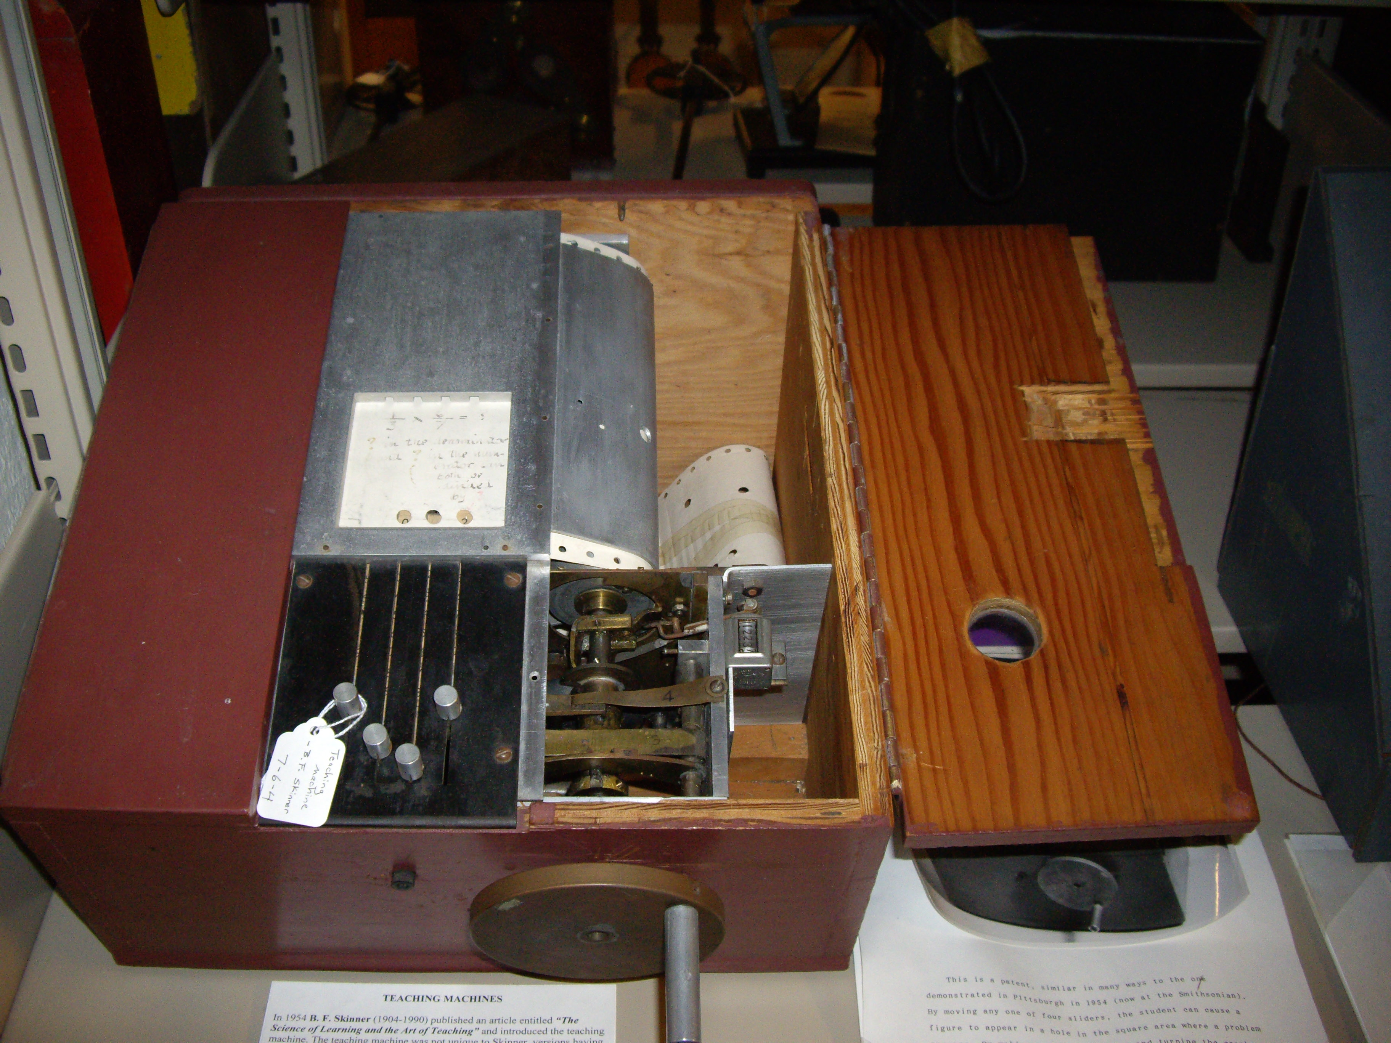
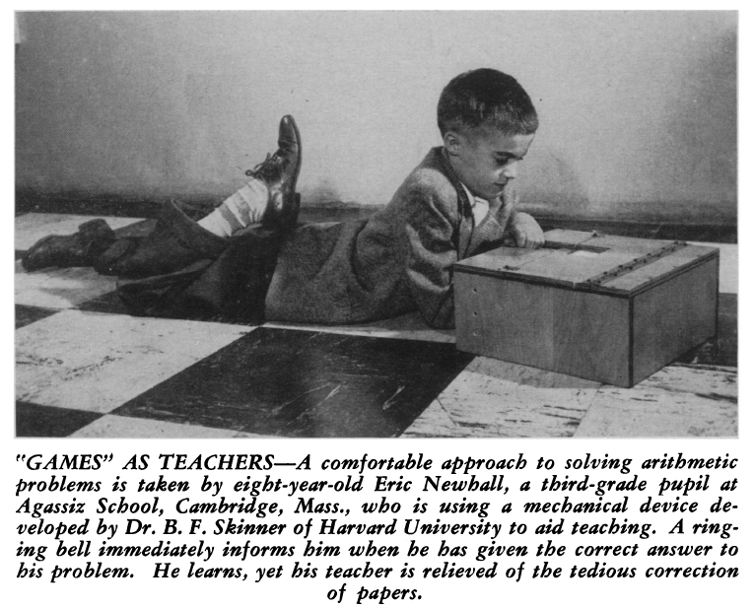
Programmed Learning Machine
Notes:
While there, McConnell was involved in developing programmed texts. Although his experience there was less than positive, McConnell never lost sight of the potential of the model.

Slide 51
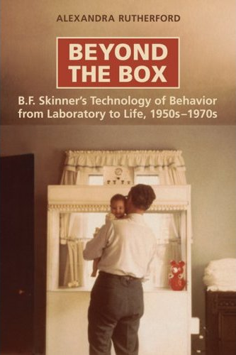
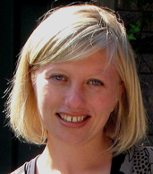
B.F. Skinner and Behavior Modification
B. F. “Fred” Skinner
Alexandra Rutherford
York University

Slide 52
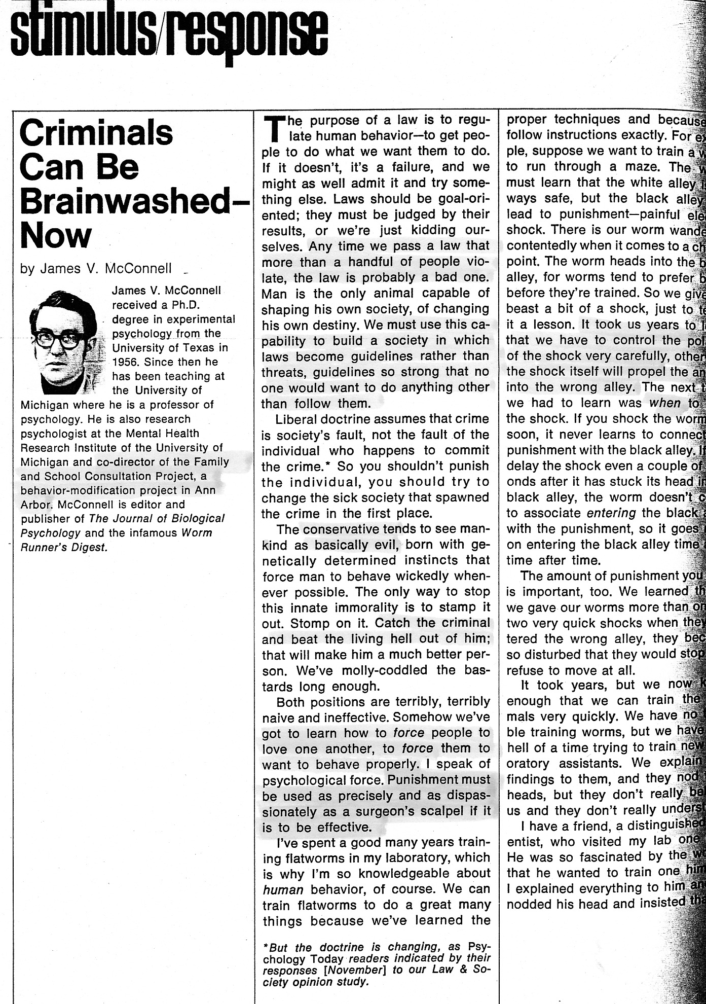
Psychology Today
April 1970
Notes:
As mentioned earlier, Rutherford demonstrates that in the early 1970s b-mod was placed under exacting scrutiny in political and social circles. This was due, in no small part, to abuses in various settings, in part to sensationalist press coverage, and also clearly to a misunderstanding by politicians and the public-at-large of all that b-mod entailed. For many, b-mod was often equated with aversive conditioning, drug therapy, electroshock, and psychosurgery.

Slide 53
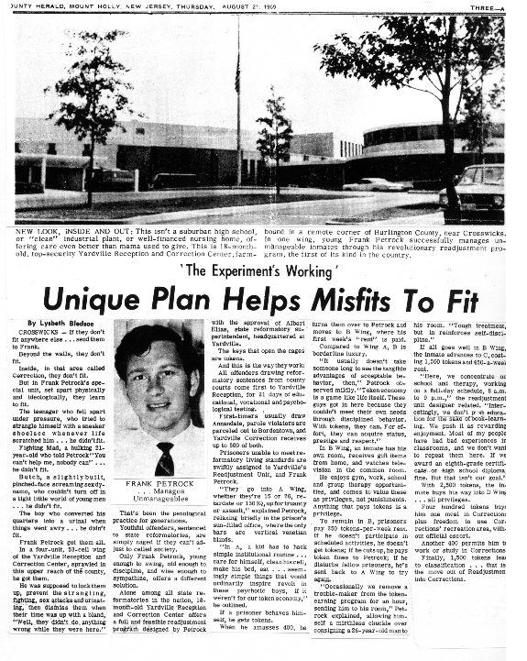
Junty Herald
Mount Holly, New Jersey
August 21, 1969
Notes:
McConnell was also quite interested in a successful token economy system set up in New Jersey by Frank Petrock. McConnell persuaded Petrock to re-locate to Ann Arbor and two token economy programs were set up – the first at the Green Oak Center at the Maxey Boys Training School under Petrock’s supervision, the second at the Vocational Residential Center at the Juvenile Court in Washtenaw County with one of McConnell’s former students, Tim Walter as Director.

Slide 54
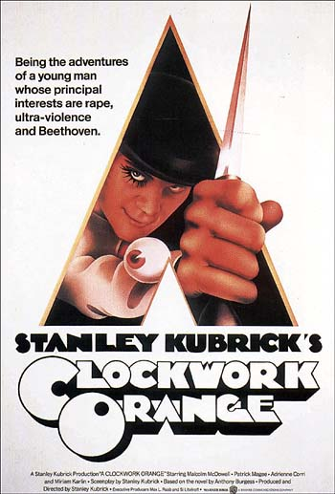
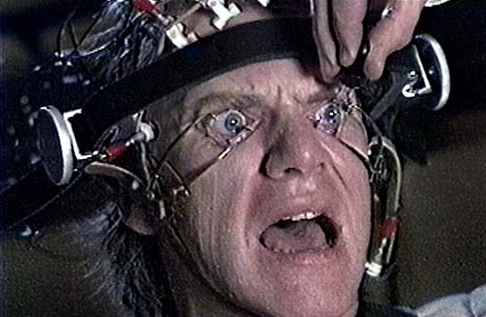
1971
4 Oscar Nominations:
Best Director
Best Picture
Best Screenplay
Best Film Editing
Gross:
$25,589,355
Notes:
The movie Clockwork Orange, appearing in 1971, garnering 4 Oscar nominations, and grossing more than $25.5 million certainly didn’t help matters.

Slide 55
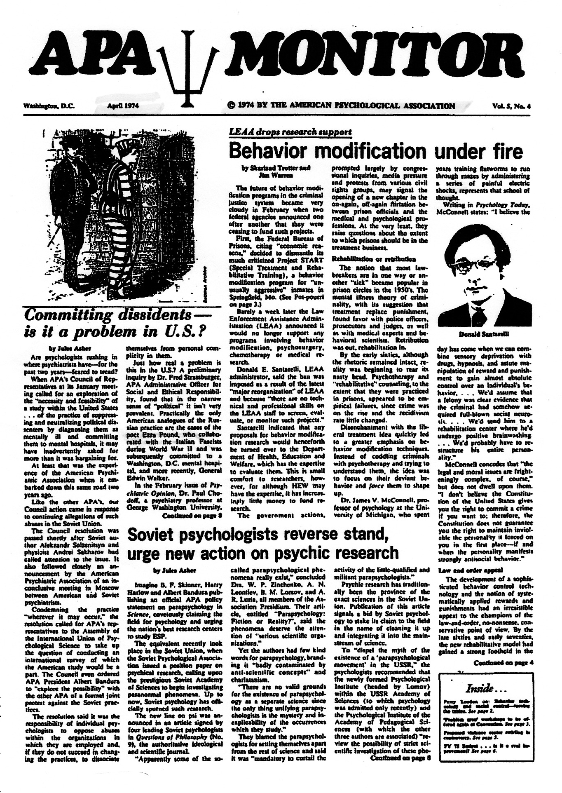
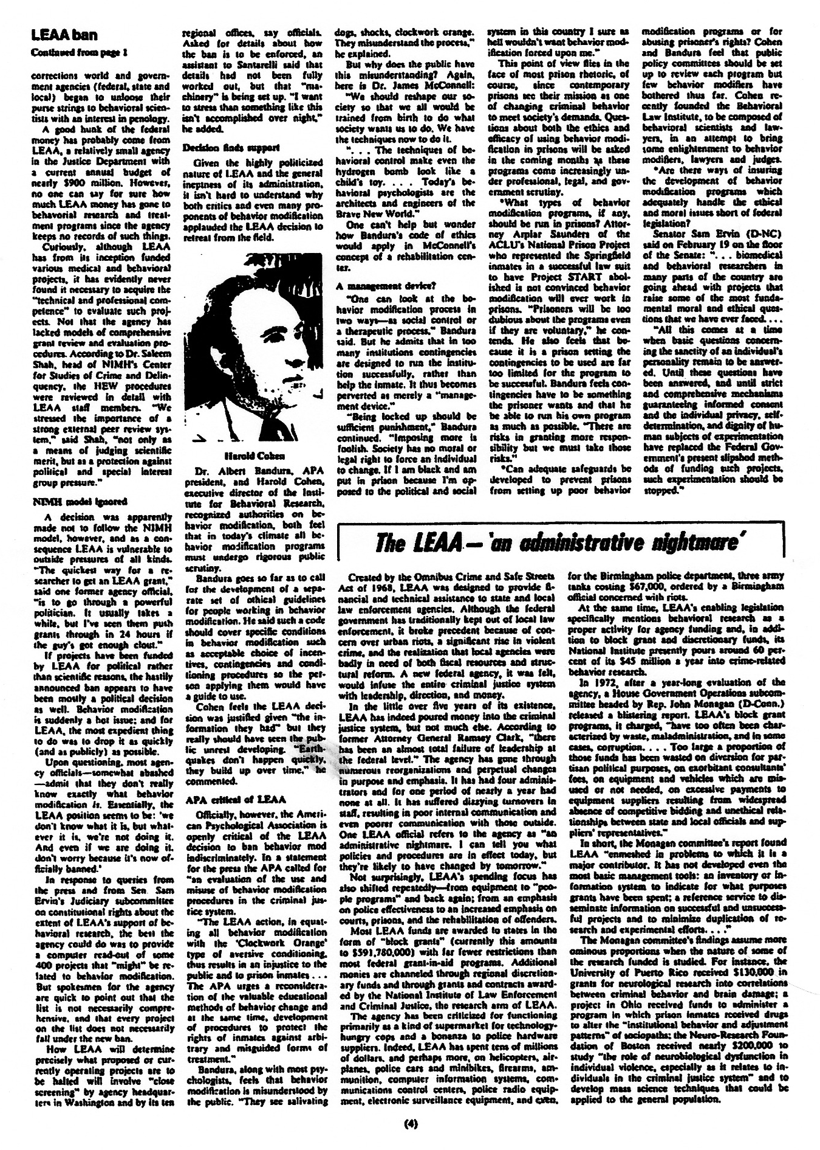
April 1974
Notes:
But nor did McConnell’s Psychology Today article. In fact, Trotter and Warren, writing in 1974 in the APA Monitor, lay the blame for the public misunderstanding at McConnell’s feet.

Slide 56
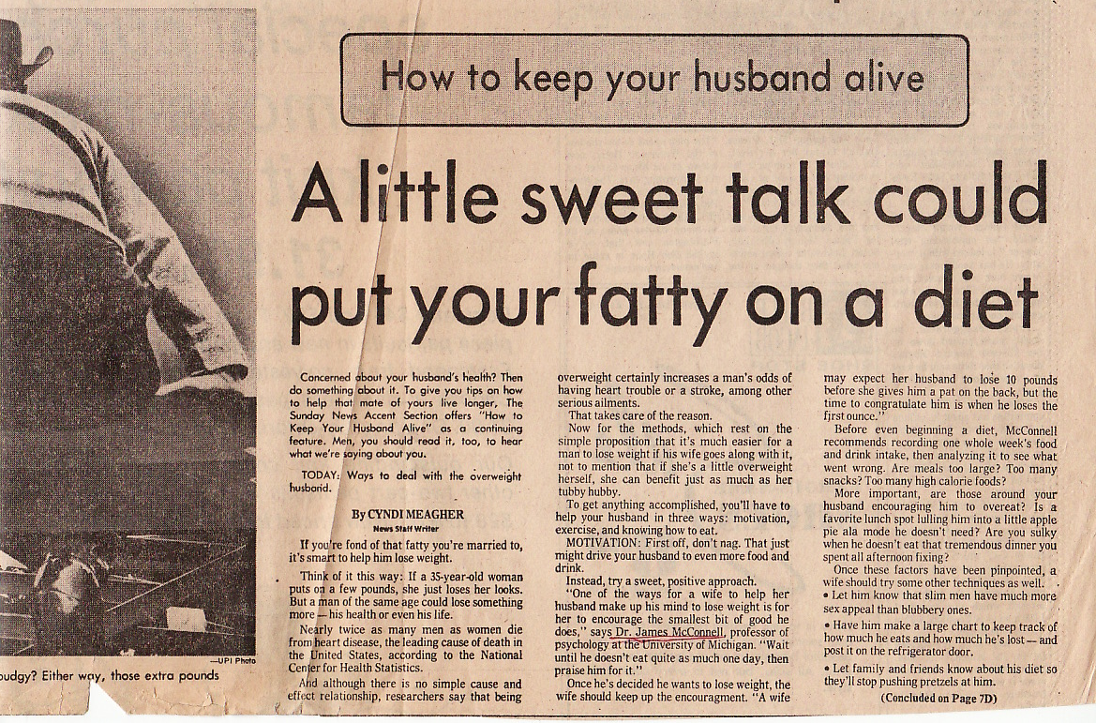
The Sunday News, Detroit
June 30, 1974
Notes:
Articles featuring or quoting McConnell on obesity appeared in 5 Michigan newspapers . . .

Slide 57
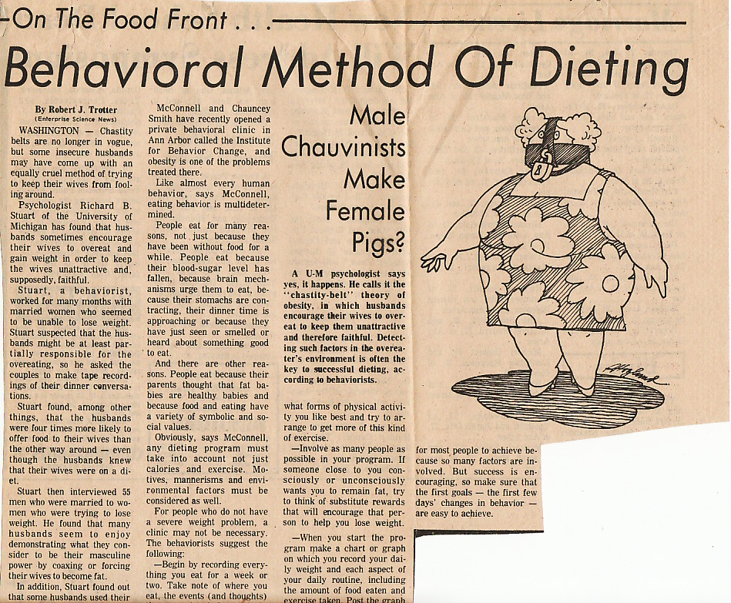
The Ann Arbor News
August 28, 1974
Notes:
. . . and the National Enquirer in 1974 and McConnell appeared with Smith on the Phil Donahue Show in 1975.

